Slide 1
Trees

Slide 2
What is a Tree
In computer science, a tree is an abstract model of a hierarchical structure
A tree consists of nodes with a parent-child relation
A rooted tree has the following properties:
  One node is distinguished as the root.
  Every node x, except the root node, is connected by and edge from exactly one other node y. Node y is parent of node x.
A
B
C
D
E
F
G
H
I
J
K

Slide 3
Tree Terminology
Root: node without parent (A)
Internal node: node with at least one child (A, B, C, F)
External node (leaf ): node without children (E, I, J, K, G, H, D)
Ancestors of a node: parent, grandparent, grand-grandparent, etc.
Depth of a node: number of ancestors
Height of a tree: maximum depth of any node (3)
Descendant of a node: child, grandchild, grand-grandchild, etc.
Subtree: tree consisting of a node and its descendants
A
subtree
B
C
D
E
F
G
H
I
J
K

Slide 4
Tree Terminology (cont.)
Path length: A unique path traverses from root to each node. The number of edges that must be followed is the path length.
Height of a node: is the length of the path from the node to the deepest leaf.
Height of a tree = Height of the root node
Siblings: nodes with the same parents.
Degree of a node: number of children of the node.
Degree of the tree = maximum degree of its nodes.
Balanced tree: difference between the depth of the leaf nodes is at most 1.
A tree with N nodes must have N-1 edges, since every node except the root has an incoming edge.

Slide 5
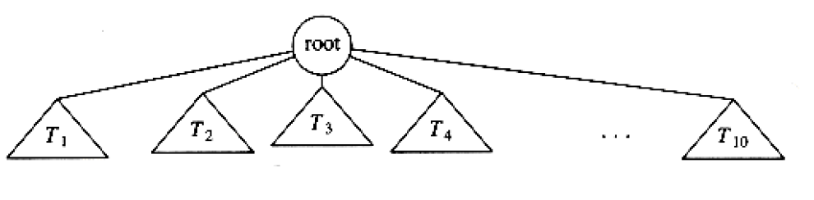
Definition of Tree
Recursive definition of the tree:
  Either a tree is empty,
  Or it consists of a root and zero or more nonempty subtrees T1, T2, … , Tk each of whose roots are connected by an edge from the root.
In certain cases, we may allow some of the subtrees to be empty.

Slide 6
Advantages and Disadvantages of
Tree Structure
To solve most of the computer science problems, we have to use tree data structure, but it requires more memory space since each node have many number of pointers.
It provides run time efficiency for solving the problems.
  Sequential search runs in O(n) time, however binary search tree requires O(lg n) time to search.
Most of the tree operations are designed as recursive functions and it is easy to implement.
Recursive functions require more memory space due to program stack usage.

Slide 7
Types of Trees in Computer Science
Binary search tree: used for searching.
Coding tree: used for text compression.
Dictionary tree (trie): used to store and search words in a dictionary.
Heap tree: used for sorting, implementing priority queues, etc.
Arithmetic expression tree: used to represent precedence of mathematical expressions.
Applications of trees:
  Organization charts
  File systems
  Programming environments

Slide 8
Tree Operations
Create the tree,
Traverse the tree,
Insert new node,
Search for a node,
Delete a node,
Save/load the nodes of the tree.

Slide 9
Implementation of Tree Data Structure
Using pointers
  Using one pointer for each child,
  Using only two pointers.
Using arrays
  Store array indices of child nodes,
  Use index expression to reach child nodes.

Slide 10
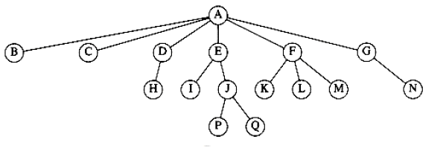
Using One Pointer for Each Child
A tree of degree m is defined as follows:
#define m 30 // degree of the tree
typedef struct degree_m{
int info;
char message[100];
struct degree_m *P[m]; // for each child a pointer is
}TREE_M; // defined
TREE_M *root=NULL;

Slide 11
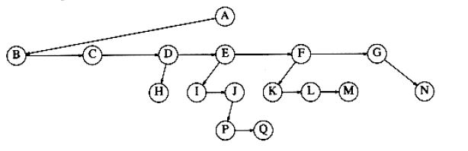
Using Only Two Pointers
A tree of degree m is defined by using two pointers as follows:
typedef struct degree_m2{
int info;
char message[100];
struct degree_m2 *c; // a pointer to the first child
struct degree_m2 *s; // a pointer to the right sibling
}TREE_M2;
TREE_M2 *root=NULL;

Slide 12
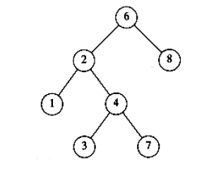
Definition of Binary Trees
Using Pointers
typedef struct bTree{
int info;
char message[100];
struct bTree *left;
struct bTree *right;
}BTREE;
BTREE *root=NULL;

Slide 13
Using Arrays and Storing Indices of Child Nodes
A tree of degree m is defined as follows:
#define m 30 // degree of the tree
#define N 1000 // number of nodes in the tree
typedef struct degree_m{
int info;
char message[100];
int P[m]; // store indices of child nodes
}TREE_M;
TREE_M T[N]; // Array which stores the tree

Slide 14
Using Arrays and Storing Indices of First Child and Right Sibling Nodes
A tree of degree m is defined by using two indices as follows:
#define N 1000 // number of nodes in the tree
typedef struct degree_m2{
int info;
char message[100];
int c; // array index of the first child
int s; // array index of the right sibling
}TREE_M2;
TREE_M2 T[N];

Slide 15
Use Index Expression to Reach Child Nodes
#define N 1000
typedef struct bTree{
int info;
char message[100];
}BTREE;
BTREE T[N];
index of the root node = 0
index of the left child of node i = 2 * i + 1
index of the right child of node i = 2 * i + 2

Slide 16
For trees having degree m
index of the root node = 0
index of the 1st child of node i = m * i + 1
index of the 2nd child of node i = m * i + 2
…
index of the mth child of node i = m * i + m

Slide 17
When array implementation should be used?
If we have full and/or balanced trees, array implementation should be preferred.
  So, it is suitable for heap trees.
It provides direct access to nodes, so it is faster than pointer based implementation.
If we have sparse and/or unbalanced trees, we should use pointer based implementation.

Slide 18
Binary Trees
Degree of the tree is 2.
Some binary tree types:
Binary search trees,
Heap trees,
Expression trees,
Coding trees.

Slide 19
Binary Search Trees
Degree of the tree = 2
For each node i of the tree:
  Left_child(i) < Node(i)
  Right_child(i) >= Node(i)
Question: Insert the following numbers into a binary search tree:
9, 5, 14, 2, 7, 13, 38, 25, 39 (balanced)
9, 14, 38, 39 (unbalanced)
9, 5, 7, 6 (unbalanced)

Slide 20
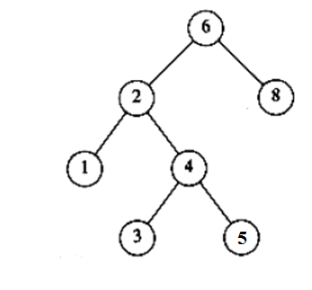
Implementation of a Binary Search Tree
typedef struct bTree{
int info;
char message[100];
struct bTree *left;
struct bTree *right;
}BTREE;
BTREE *root=NULL;

Slide 21
Insertion
If the tree is empty,
  insert into the root node
Else
  If value of the new node is less than the root node
    Continue with the left subtree
  Else
    Continue with the right subtree

Slide 22
Insertion function
void insert(BTREE *treeRoot, BTREE *newNode){
if (treeRoot == NULL)
root = newNode;
else {
if (newNode->info < treeRoot->info){
if (treeRoot->left == NULL)
treeRoot->left = newNode;
else
insert(treeRoot->left,newNode);
}
else{
if (treeRoot->right == NULL)
treeRoot->right = newNode;
else
insert(treeRoot->right,newNode);
}
}
}

Slide 23
Traversing the Tree
Pre-order traversal:
root, left, right
6, 2, 1, 4, 3, 5, 8
In-order traversal:
left, root, right
1, 2, 3, 4, 5, 6, 8
Post-order traversal:
left, right, root
1, 3, 5, 4, 2, 8, 6

Slide 24
Traversal function
// pre-order traversal
void traverse(BTREE *treeRoot){
if (treeRoot != NULL){
printf("%d %s\n",treeRoot->info,
treeRoot->message);
traverse(treeRoot->left);
traverse(treeRoot->right);
}
}

Slide 25
Searching for a node
While root is not null and item is not in the root
if item < root
go to left
else
go to right
Return root

Slide 26
Search function
BTREE *search(BTREE *treeRoot, int item){
while ((treeRoot != NULL) &&
(treeRoot->info != item)){
if (item < treeRoot->info)
treeRoot = treeRoot->left;
else
treeRoot = treeRoot->right;
}
return treeRoot;
}

Slide 27
Deleting a node
q: node to be deleted
qa: parent of q
Find q and qa
If q is not found
  Exit from the function
If q has 2 children
  Find the node s having the highest value in the left subtree
  Copy s to q
Now, delete the node having at most 1 children
Free space occupied by the deleted node.

Slide 28
Deletion function
BTREE *delete(BTREE *treeRoot, int item){
BTREE *qa, *q, *qc, *sa, *s;
if (treeRoot == NULL)
return NULL;
q = treeRoot;
qa = NULL;
// find the item to be deleted
while ((q != NULL) && (q->info != item)){
qa = q;
if (item < q->info)
q = q->left;
else
q = q->right;
}
if (q == NULL){
printf("Item to be deleted is not found\n");
return NULL;
}

Slide 29
Deletion function (cont.)
// if q is found and it has 2 children
if ((q->left != NULL) && (q->right != NULL)) {
s = q->left;
sa = q;
// Find item having the max value in the left
// subtree. So, take the rightmost node
// in the left subtree.
while (s->right != NULL){
sa = s;
s = s->right;
}
q->info = s->info; // copy s to q
strcpy(q->message, s->message);
q = s;
qa = sa;
}

Slide 30
Deletion function (cont.)
// now q has at most 1 child, and find it
if ((q->left != NULL)
qc = q->left;
else
qc = q->right;
// delete q
if (q == treeRoot)
root = qc;
else {
if (q == qa->left)
qa->left = qc;
else
qa->right = qc;
}
free(q);
return q;
}

Slide 31
Create Node function
BTREE *readNode(){
BTREE *newNode;
newNode = (BTREE *)malloc(sizeof(BTREE));
if (newNode == NULL)
return NULL;
printf("Enter info:");
scanf("%d",&(newNode->info));
printf("Enter message:");
scanf("%s",newNode->message);
newNode->left = NULL;
newNode->right = NULL;
return newNode;
}

Slide 32
Count Number of Nodes in the Tree
int countNodes(BTREE *treeRoot, int sum){
if (treeRoot == NULL)
return sum;
sum++;
sum = countNodes(treeRoot->left,sum);
sum = countNodes(treeRoot->right,sum);
return sum;
}

Slide 33
main() function
main(){
BTREE *n , *a;
int i, amount, choice;
while (1){
printf(" 1. Insert a node \n
2. Delete a node \n
3. List nodes \n
4. Search for a node \n
5. Count number of nodes \n
6. Exit \n
Enter your choice: ");
scanf("%d",&choice);

Slide 34
main() function (cont.)
if (choice == 1){
n = readNode();
insert(root,n);
}
else if (choice == 2){
printf("Enter node to be deleted…");
scanf("%d",&i);
a = delete(root,i);
if (a != NULL)
printf("Deleted\n");
else
printf("Item to be deleted
is not found\n");
}

Slide 35
main() function (cont.)
else if (choice == 3){
if (root != NULL){
traverse(root);
else
printf("Tree is empty\n");
}
else if (choice == 4){
printf("Enter node to be searched for…");
scanf("%d",&i);
a = search(root,i);
if (a == NULL)
printf("Item is not found\n");
else
printf("%d %s \n", a->info, a->message);
}

Slide 36
main() function (cont.)
else if (choice == 5){
count = countNodes(root,0);
printf("Number of nodes
in the tree = %d \n", count);
}
else
break;
}
}

